Slide 1
Web Course
Games Academy January 2016
Benjamin Nitschke - Delta Engine
Notes:
Database and Server Side Programming Course

Slide 2
Overview
Day 1: HTML5 & JavaScript
Standards, Performance, Frameworks, Ajax, Node.js
Day 2: ASP.Net
Using C# to build websites, how to deploy and integrate
Day 3: TypeScript
Setup, Compatibility, Benefits

Slide 3
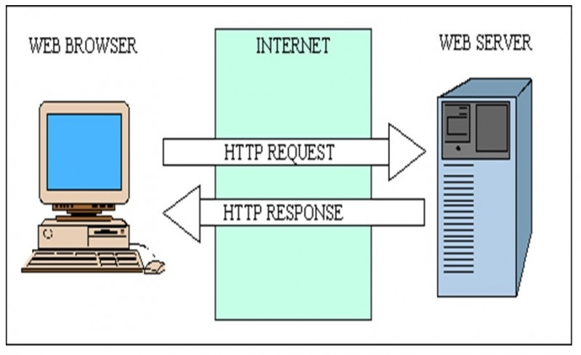
How the Web works

Slide 4
Overview
We will use the example game Pong with PongServer from the NetworkingCourse and DatabaseCourse and build a website for it. The PongServer allows multiplayer gameplay and features player accounts, high-scores and statistics support for each game session is added.
This data is saved on the server-side and used for analysis and presenting the data (e.g. high-scores) in game and on a website for the game we will build.

Slide 5

Example WebGL Game
Notes:
http://deltaengine.net/Samples/GhostWars/

Slide 6
Quotes
“Writing old school HTML code was never very much fun but now it's getting downright tedious for most people.” - Mike Davidson
“If you think math is hard, try web design.” ―Trish Parr
“Great web design without functionality is like a sports car with no engine.” ― Paul Cookson
“Facebook is so ubiquitous now that it's like another manifestation of the web itself.” - Max Levchin
Notes:
Sources: https://news.ycombinator.com/item?id=9946399
http://stgray.com/quotes/programmingquotes.html

Slide 7
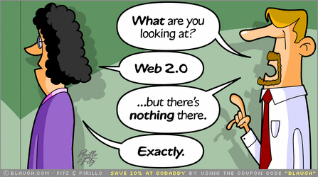
Comics
Notes:
Source: http://bloggerstop.net/2009/10/blaughing-over-blogging.html

Slide 8
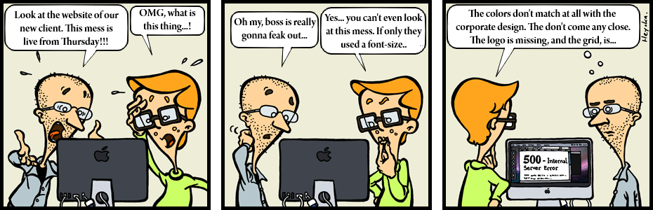
Comics

Slide 9
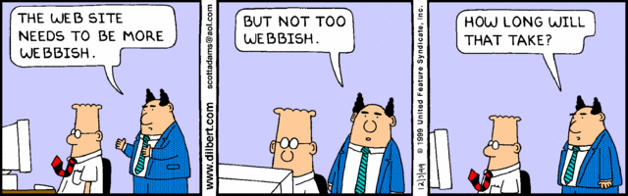
Comics
Notes:
Sources: www.dilbert.com
http://www.silkstream.net/blog/2014/12/top-10-funniest-web-design-comics.html

Slide 10
Testing your knowledge
What does HTML stand for?
Describe a way to position any HTML element.
How to change text color and size?
How are css or js files referenced in HTML?
What is the first tag used for HTML5?
How to ask for text input on a website?
How to play a video or music file on a website?
Write on paper or use //fs2/pub$/Web/<YourName>
Time: 3 minutes, don’t talk or cheat with google

Slide 11
Answers
What does HTML stand for?
HyperText Markup Language
Describe a way to position any HTML element.
via <div> and using styles (like the one below, in HTML5 it is the most common way to position and layout via css)
via style: position: relative/fixed/absolute; left: 30px;
via <table><tr><td>...</td></tr></table> (for tabular data)
Notes:
https://developer.mozilla.org/en-US/docs/Web/HTML

Slide 12
Let’s look at a layout example
<html><head><style>
nav {
float:left;
background-color:lightgray;
height:200px;
width:100px;
padding:5px;
line-height:30px;
}
section {
float:left;
width:350px;
padding-left:20px;
}
</style></head>
<body>
<nav>
Overview<br>
Screenshots<br>
Download<br>
About<br>
</nav>
<section>
<h1>About</h1>
<p>We are the greatest development studio ever .. bla bla
</section>
</body>
</html>
Notes:
http://www.w3schools.com/html/tryit.asp?filename=tryhtml_default
Enter your own layout and content, if everyone knows HTML well already we can skip this

Slide 13
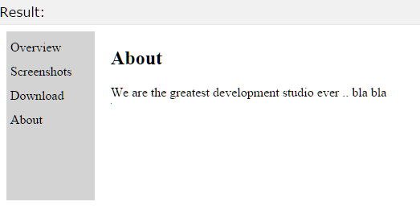
Let’s look at a layout example
Notes:
http://www.w3schools.com/html/tryit.asp?filename=tryhtml_default

Slide 14
Answers
How to change text color and size?
Just write some text in a <span> or <div> and style it with css: font-size: 30px; color: red
Obsolete (not part of HTML5 standard): via <font size=”3” color=”red”>some text</font>
How are css or js files referenced in HTML?
<link rel="stylesheet" type="text/css" href="mystyle.css">
<script src="https://maps.googleapis.com/maps/api/js"></script>
Notes:
https://developer.mozilla.org/en-US/docs/Web/HTML

Slide 15

Let’s look at a include js example
<html><head>
<script src="https://maps.googleapis.com/maps/api/js"></script>
</head>
<body>
<h1>Games Academy Berlin with Google Maps</h1>
<div id="map" style="width:800px;height:600px"></div>
<script>
var mapCanvas = document.getElementById("map");
var mapOptions = { center: new google.maps.LatLng(52.5125, 13.4198), zoom: 18 }
var map = new google.maps.Map(mapCanvas, mapOptions);
</script>
</body></html>
Notes:
http://www.w3schools.com/howto/tryit.asp?filename=tryhow_google_map_4

Slide 16
Answers
What is the first tag used for HTML5?
<!DOCTYPE html>
How to ask for text input on a website?
Ugly way: prompt("Please enter your name", "");
Better: <input id="Name" value="">
but this needs JavaScript to handle: <button onclick="setName()">Set Name</button> <p id="output”></p> <script>function setName() { document.getElementById("output").innerHTML = document.getElementById("Name").value; } </script>
Notes:
http://www.w3schools.com/jsref/tryit.asp?filename=tryjsref_password_value
http://www.w3schools.com/sql/sql_select.aspWe will go through these in more details in a second

Slide 17
Answers
How to play a video or music file on a website?
<html><body>
<button onclick="playVid()" type="button">Play Video</button><br>
<video id="myVideo" width="640" height="352">
<source src="http://www.w3schools.com/html/mov_bbb.mp4" type="video/mp4"> Your browser does not support HTML5 video.
</video>
<script>
var vid = document.getElementById("myVideo");
function playVid() { myVideo.play(); }
function pauseVid() { myVideo.pause(); }
</script>
</body></html>
Notes:
http://www.w3schools.com/html/html5_video.asp

Slide 18
Client-Side Scripting (i.e. JavaScript)
All what we have done so far is Client-Side
Executes in the Browser, ease of deployment
Once the Browser changes, your stuff might break
Lots of headaches without standards
IE, FireFox and Chrome were all very different at first
IE 1-6 are horrible to support
Nowadays things are much more stable
But there are still differences
Still, not everything can be done (server database access)

Slide 19
Why is JavaScript important?
It is pretty much the only choice to run software in the browser (no one wants to install extra plugins, flash is over, unity canceled its web plugin, silverlight is no more, activex is outdated and unused for 10+ years, many more examples)

Slide 20
AJAX
Asynchronous JavaScript and XML
Change content of a website dynamically
Good example: Google Maps
Doing fun stuff on the client directly like Games (impossible with server side HTML)
Preprocessing input
All the benefits from HTML are true here too

Slide 21
JavaScript - The Dark Side
However JavaScript has a lot of flaws, strange ways to make things work, very broken language design and even bugs in the library, it is plain ugly
Browsers have evolved around that and improved performance again and again, it is still slower than native apps, but many common tasks and libraries execute very fast nowadays

Slide 22
JavaScript Obfuscation
JavaScript obfuscation: www.jasob.com
Otherwise the user can easily read the plain source code we wrote
You can do this on any website you visit -> just right click -> view source code or use the developer mode of your browser

Slide 23
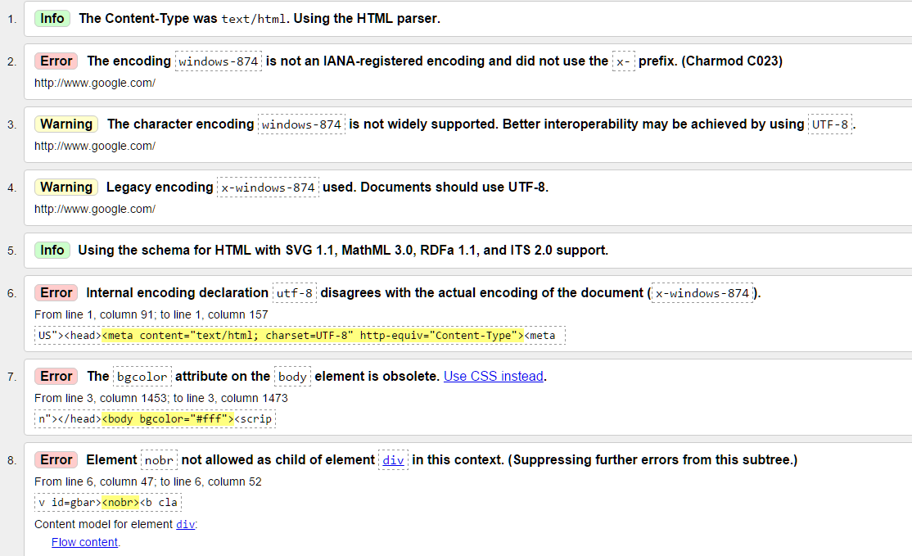
HTML5 compliance & validation
Pretty much no website complies to it, e.g. google.com
Notes:
https://validator.w3.org/nu/?doc=http%3A%2F%2Fwww.google.com%2F

Slide 24
How to edit HTML, CSS and JS
Any text editor will work, believe it or not, most web development happens in Notepad, Notepad++, TextEdit, vim and similar simple text editors.
Most editors support syntax highlighting
For newbies there are a lot of web hosting options
http://www.web.com/site
or anything your provider gives you: 1und1, strato, etc.
or even complete specific systems like wordpress.com
Notes:
https://en.wikipedia.org/wiki/List_of_HTML_editors
https://en.wikipedia.org/wiki/Website_builder

Slide 25
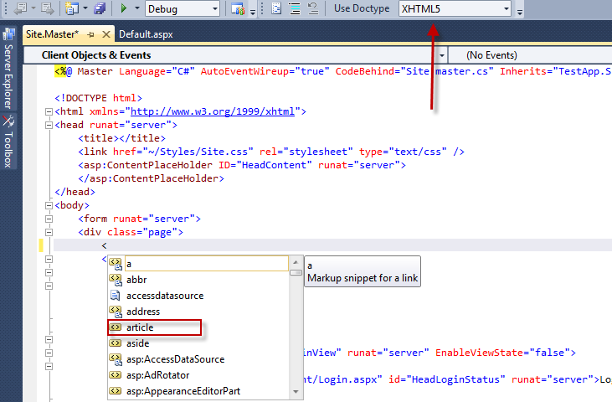
How to edit HTML, CSS and JS
Or just use a IDE you are comfortable with, it will most likely support HTML, CSS and JavaScript editing!
Notes:
https://msdn.microsoft.com/en-us/library/9z74w20y(v=vs.110).aspx
We will continue with this on Day 2

Slide 26
Learning JavaScript
Mostly by just using it
you create a website, you will run into issues
Free online book to learn JavaScript: http://eloquentjavascript.net/
If you know C# or Java, the syntax is easy
However: Beware of automatic ; adding in JS

Slide 27
Frameworks
Too many choices to list for server side code
Use JavaScript too (like on client side) <- Todays topic
PHP (very popular in the past 20 years, e.g. facebook)
Perl
ASP.NET (C# or VB.Net)
Many languages also have solutions
Java, Scala and other languages on top of JVM
C, C++, Lisp, D, Cobol, who wants to use that?
Obsolete: ActiveX, Java Applets, Flash, Silverlight, Unity3D
Notes:
https://en.wikipedia.org/wiki/Comparison_of_web_frameworks
We can talk a bit about this

Slide 28
Node.js
Node.js® is a JavaScript runtime built on Chrome's V8 JavaScript engine. Node.js uses an event-driven, non-blocking I/O model that makes it lightweight and efficient. Node.js' package ecosystem, npm, is the largest ecosystem of open source libraries in the world.

Slide 29
Installing Node.js
First install Node.js (via NPM)
Simpliest way: https://nodejs.org/en/download
NPM is the package manager and very useful: https://www.npmjs.com/
Once installed, try it in the command line:
node
console.log(“Hi Games Academy”);
Notes:
http://nodeguide.com/beginner.html

Slide 30
Using MongoDB with Node.js
var MongoClient = require('mongodb').MongoClient; var assert = require('assert');
// See DatabaseCourse for connection details var url = 'mongodb://localhost:27017/Pong'; MongoClient.connect(url, function(err, db) { assert.equal(null, err); console.log("Connected correctly to server."); db.close(); });
Notes:
https://docs.mongodb.org/getting-started/node/client/

Slide 31
Live Coding a website
Simple website to show
high scores and
game statistics
Using the MongoDB database and the existing PongServer data. Access is done via Node.js
Day 2 and Day 3 will look at other ways
Notes:
https://docs.mongodb.org/ecosystem/drivers/node-js/

Slide 32
Questions?
All code and these slides are available at:
https://github.com/BenjaminNitschke/WebCourse

Slide 33
Day 2: Recap of Day 1
What we did so far
HTML5 & CSS Refresher
JavaScript client side: Input, Maps, etc.
Overview of Frameworks & JS Tools
JavaScript on the server via Node.js
NPM Package Management
Live Coding a Node.js webserver
MongoDB Database support

Slide 34
Day 2: ASP.Net Forms
Walkthrough: https://msdn.microsoft.com/en-us/library/9z74w20y(v=vs.110).aspx

Slide 35
Create ASP.Net Forms webpage
Based on what we just learned re-create yesterdays Pong Highscores website in ASP.Net
Import the HtmlWebsite css and html
https://github.com/BenjaminNitschke/WebCourse
Get the menu working (Highscores, About)
Optional: Get Highscores from a file or db
Time: 45 Minutes, feel free to pair or ask for help

Slide 36
From the DatabaseCourse
<!DOCTYPE html><html xmlns="http://www.w3.org/1999/xhtml">
<head runat="server"><title>Pong High Scores</title></head>
<body>
<form id="form1" runat="server">
<div>
<h2>Pong High Scores</h2>
</div>
<asp:SqlDataSource ID="SqlHighScoreDataSource" runat="server"
ConnectionString="<%$ ConnectionStrings:PongConnectionString %>"
SelectCommand="SELECT Username, [Score], [PositionInRanking] FROM [HighScore] JOIN Player On Player.Id = PlayerId ORDER BY [PositionInRanking]"></asp:SqlDataSource>
<asp:GridView ID="GridView1" runat="server" AutoGenerateColumns="False" DataSourceID="SqlHighScoreDataSource" AllowPaging="True" AllowSorting="True" Height="161px" Width="834px">
<Columns>
<asp:BoundField DataField="PositionInRanking" HeaderText="Global Rank" SortExpression="PositionInRanking" />
<asp:BoundField DataField="Username" HeaderText="Player" SortExpression="Username" />
<asp:BoundField DataField="Score" HeaderText="Score" SortExpression="Score" />
</Columns>
</asp:GridView></form></body></html>

Slide 37
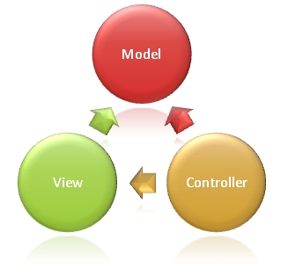
ASP.NET MVC
MVC is one of three ASP.NET programming models.
MVC is a framework for building web applications using a MVC (Model View Controller) design:
The Model represents the application core (for instance a list of database records).
The View displays the data (the database records).
The Controller handles the input (to the database records).
The MVC model also provides full control over HTML, CSS, and JavaScript.
Notes:
Continue visiting https://msdn.microsoft.com/en-us/library/9z74w20y(v=vs.110).aspx for setup

Slide 38
ASP.NET MVC
Like before, let’s go through a walkthrough to create a simple MVC 6 ASP.NET website (using VS 2015):
http://docs.asp.net/projects/mvc/en/latest/getting-started/first-mvc-app/start-mvc.html
Notes:
Continue visiting https://msdn.microsoft.com/en-us/library/9z74w20y(v=vs.110).aspx for setup

Slide 39
Live Coding a MVC ASP.Net website
Let’s do it all over again:
Menu with high scores and about
Database access (Model)
Controller to process logic (pass through)
Views to show data in a pretty format
Like yesterday we will utilize templates and existing technology (routes, error handling, etc.)
Notes:
Since this will go much quicker than yesterdays REPL like Node.js programming we can add tons of new features: Search, Paging, Sorting, etc.
http://docs.asp.net/projects/mvc/en/latest/getting-started/first-mvc-app/controller-methods-views.html

Slide 40
Questions?
All code and these slides are available at:
https://github.com/BenjaminNitschke/WebCourse

Slide 41

Day 3: TypeScript
Notes:
http://www.typescriptlang.org

Slide 42
Day 3: TypeScript
TypeScript is a language for application-scale JavaScript development. TypeScript is a typed superset of JavaScript that compiles to plain JavaScript. Any browser. Any host. Any OS. Open Source.
Notes:
Quote from TypeScript creators, see http://todomvc.com/examples/typescript-angular/#/

Slide 43
Day 3: TypeScript
TypeScript is:
JavaScript with optional typing.
TypeScript is a compiled language, not interpreted
100% backwards compatible with JavaScript
just copy+paste some JS code, it works
All the extra language features only exist at compile time
TypeScript simply outputs plain JavaScript
Pretty easy to learn and get started
Integrated into VS2015 or test via PlayGround
Notes:
http://blog.teamtreehouse.com/typescript-hot-now-looking-forward
http://www.typescriptlang.org

Slide 44
Day 3: TypeScript
Tons of good resources right from the source:
http://www.typescriptlang.org/Tutorial
http://www.typescriptlang.org/Playground/#tut=ex1
http://www.typescriptlang.org/Samples#TodoMVC
http://www.typescriptlang.org/Handbook
https://github.com/Microsoft/TypeScript/blob/master/doc/spec.md
https://angular.io/docs/ts/latest/quickstart.html
http://blog.teamtreehouse.com/getting-started-typescript

Slide 45
AngularJS
One framework. Mobile and desktop.
Fast & good for mobile: Angular computes updates based on changes to data, not DOM
Flexible: Supports several languages including plain JavaScript, TypeScript, and Dart
https://angular.io/docs/ts/latest/quickstart.html
https://angular.io/docs/ts/latest/tutorial/toh-pt1.html
Notes:
https://angular.io/
Clean code, one of the creators at google: Misko Hevery is a early adopter of clean code and was talking about doing TDD 8+ years ago.

Slide 46
Live Coding a TypeScript website
Let’s do it all over again:
Using AngularJS and TypeScript
Menu with high scores and about
Database access (Model)
Controller to process logic (pass through)
Views to show data in a pretty format
with the same html and css from the last days
Notes:
Similar to http://todomvc.com/examples/typescript-angular/#/
Node.js with TypeScript: https://basarat.gitbooks.io/typescript/content/docs/node/nodejs.html

Slide 47
Node.js TypeScript Web Server
Steps to compile & build
In VS: Edit app.ts file
In VS: Build -> app.js
Cmd: stop server (Ctrl+C, Ctrl+C)
Cmd: npm server
Browser: F5 to refresh page
A bit annoying to create a better build system ..

Slide 48
Other Web Topics of interest
Let’s talk about
Content Management Systems (CMS)
Examples: Sitefinity, Joomla, Wordpress
Integration examples
YouTube, Wordpress
Analytics
Google Analytics
Anything else you want to know?
Notes:
Let’s look at some real world examples from production.

Slide 49
Questions?
All code and these slides are available at:
https://github.com/BenjaminNitschke/WebCourse

Slide 50
Web Books
The JavaScript Pocket Guide
http://www.amazon.com/dp/0321700953/ (by Lenny Burdette)
CSS Pocket Reference 4th Edition
http://www.amazon.com/dp/1449399037 by Eric A. Meyer
http://www.asp.net/mvc/books
Best one: Professional ASP.NET MVC 4 (by Jon Galloway, Phil Haack, Brad Wilson, K. Scott Allen)
https://github.com/basarat/typescript-book
Notes:
http://www.sqlservercentral.com/Books/
There are many SQL and database books out there, I do not own a single one and you probably don’t need one either, everything can be found online and learning by doing is totally okay for SQL

Slide 51
Web Development Links
https://developer.mozilla.org/en-US/docs/Web/HTML
http://www.w3schools.com/html/tryit.asp?filename=tryhtml_default
https://en.wikipedia.org/wiki/List_of_HTML_editors
https://nodejs.org/en/
https://docs.mongodb.org/ecosystem/drivers/node-js/
http://www.asp.net/
http://www.w3schools.com/aspnet/mvc_intro.asp
http://www.typescriptlang.org/

